Slide 1
The Application of a Real-Time Operational Water Resources Decision Support System (DSS) for the Orange-Fish-Sundays Water Transfer Scheme
Pieter Retief
18th October 2012
Algoa Reconciliation Strategy: Administrative and Technical Support Group 4th Meeting

Slide 2
PRESENTATION OUTLINE
Introduction and background
Framework description
Simulation modelling
Water User Management
Project dashboards
Conclusion, outcomes and recommendations

Slide 3
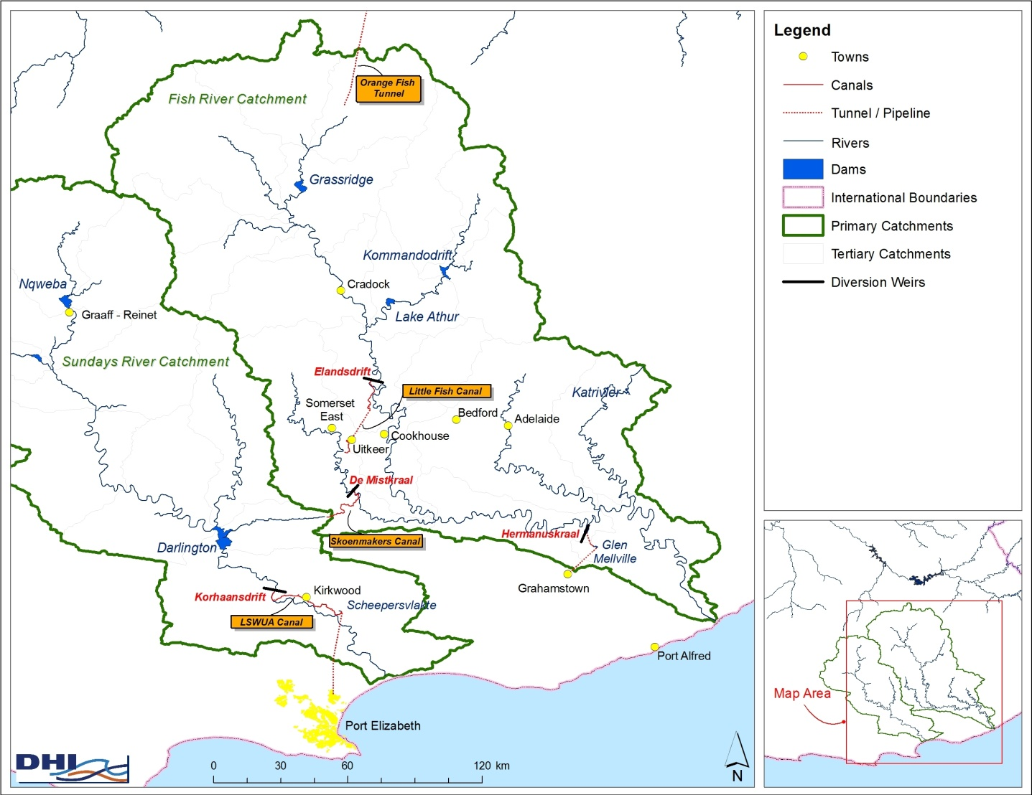
INTRODUCTION

Slide 4
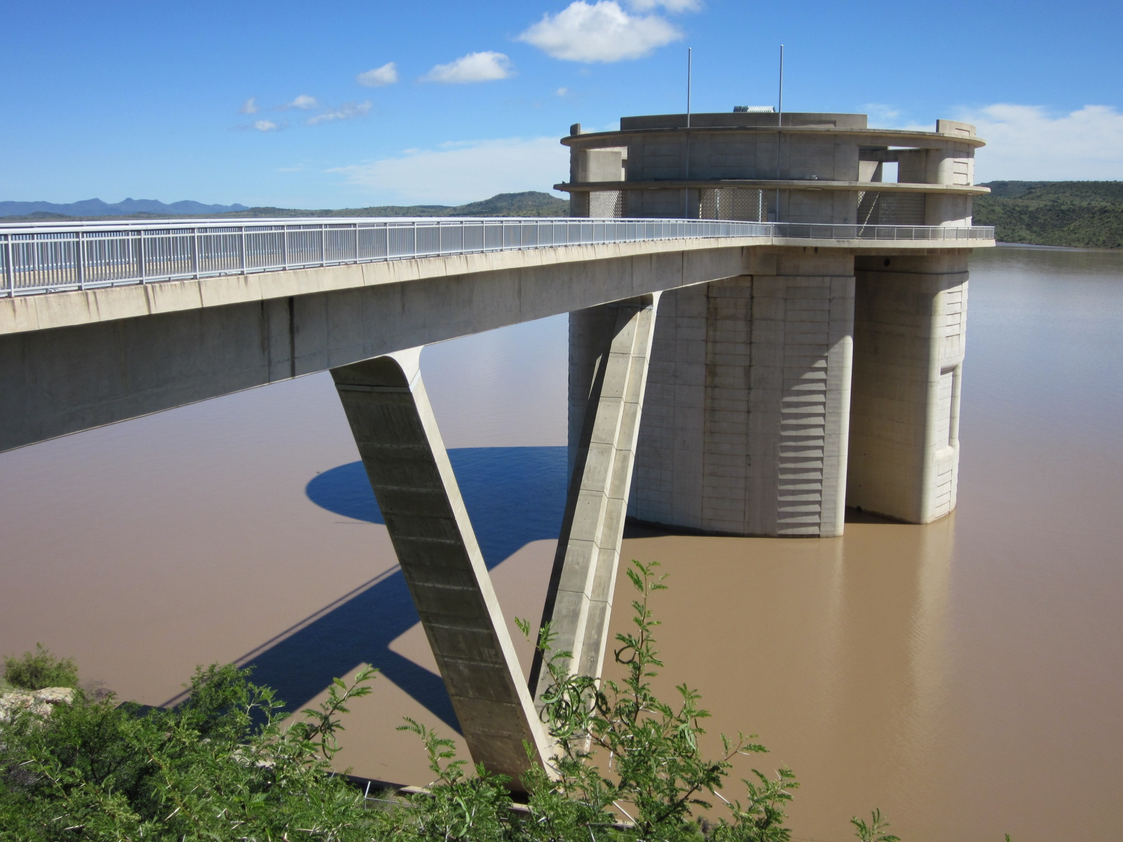
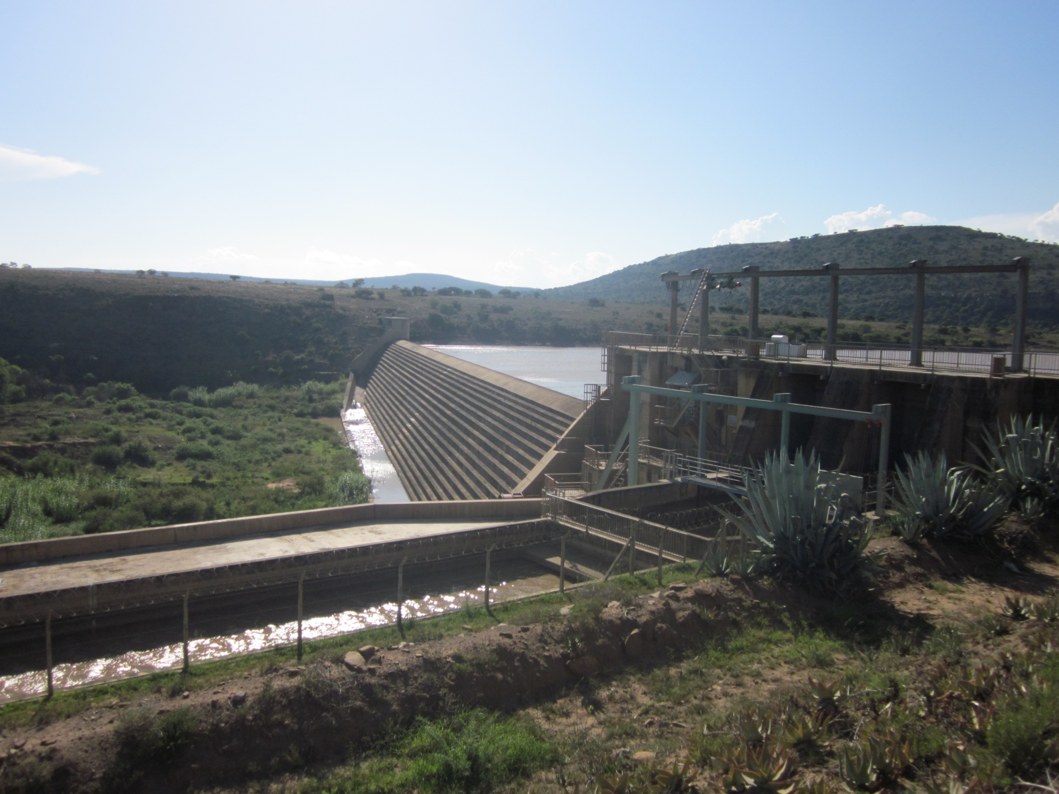
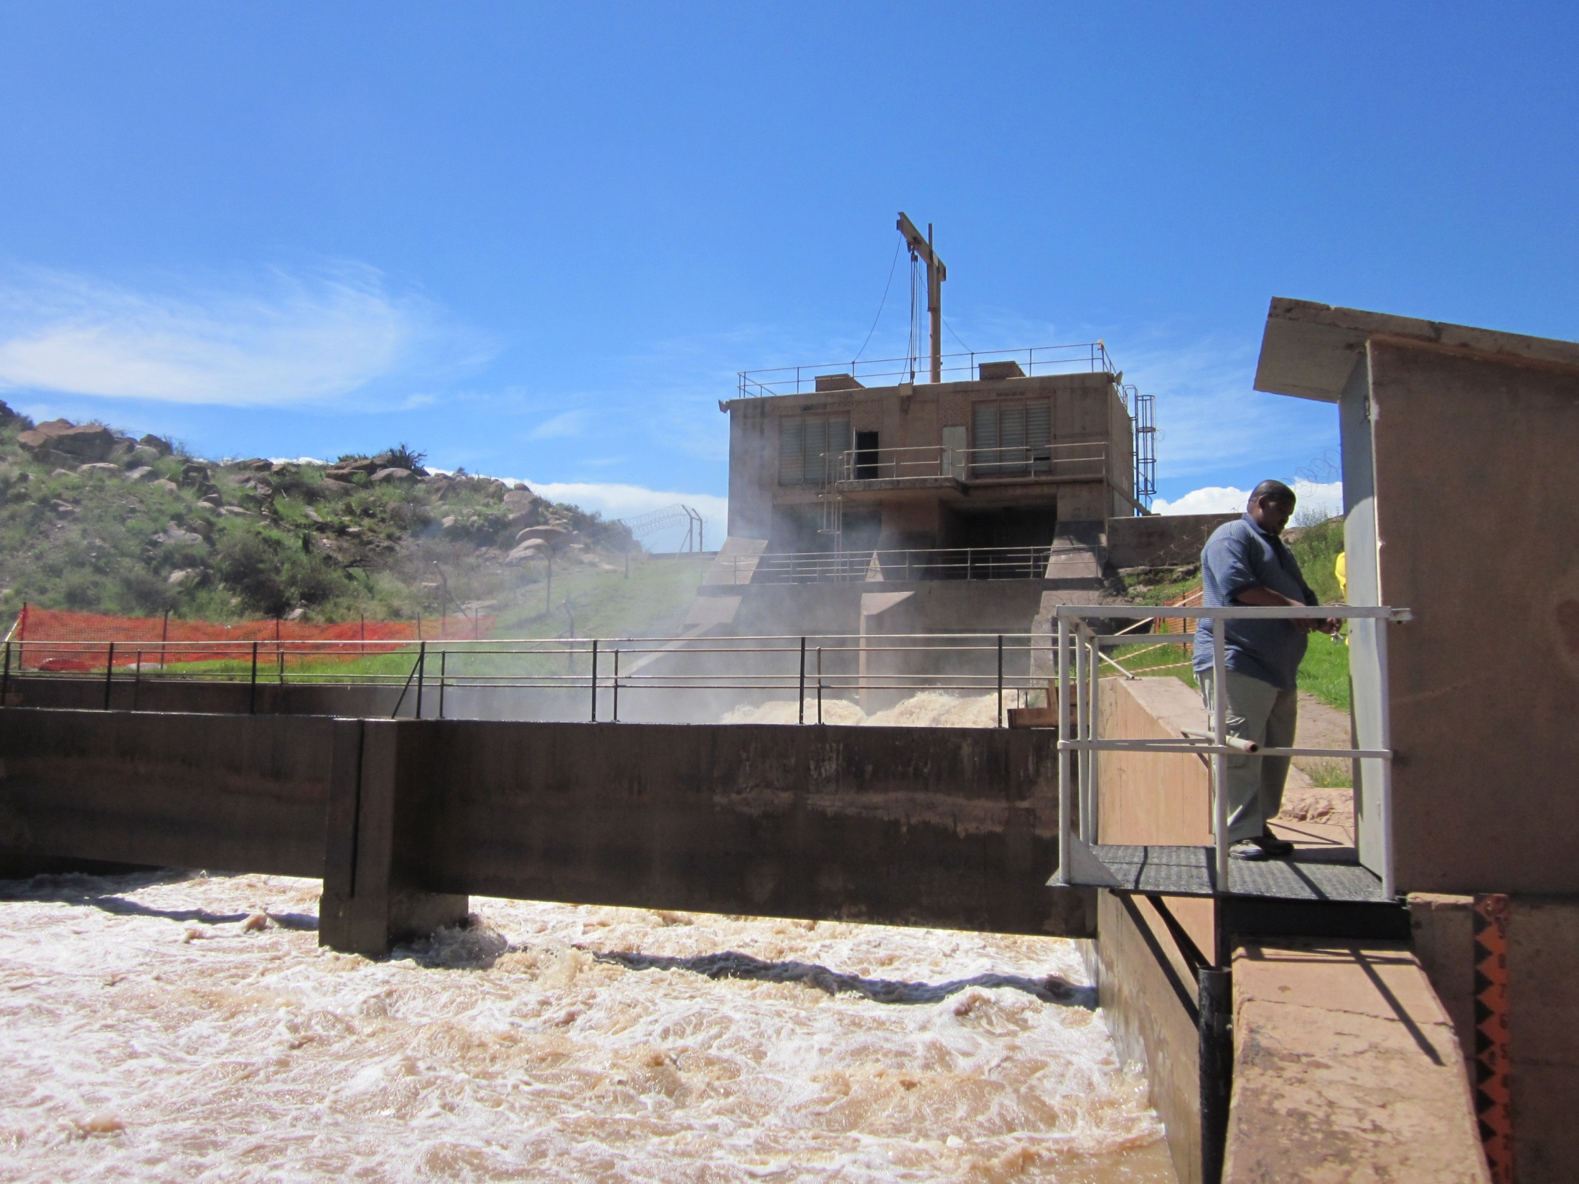
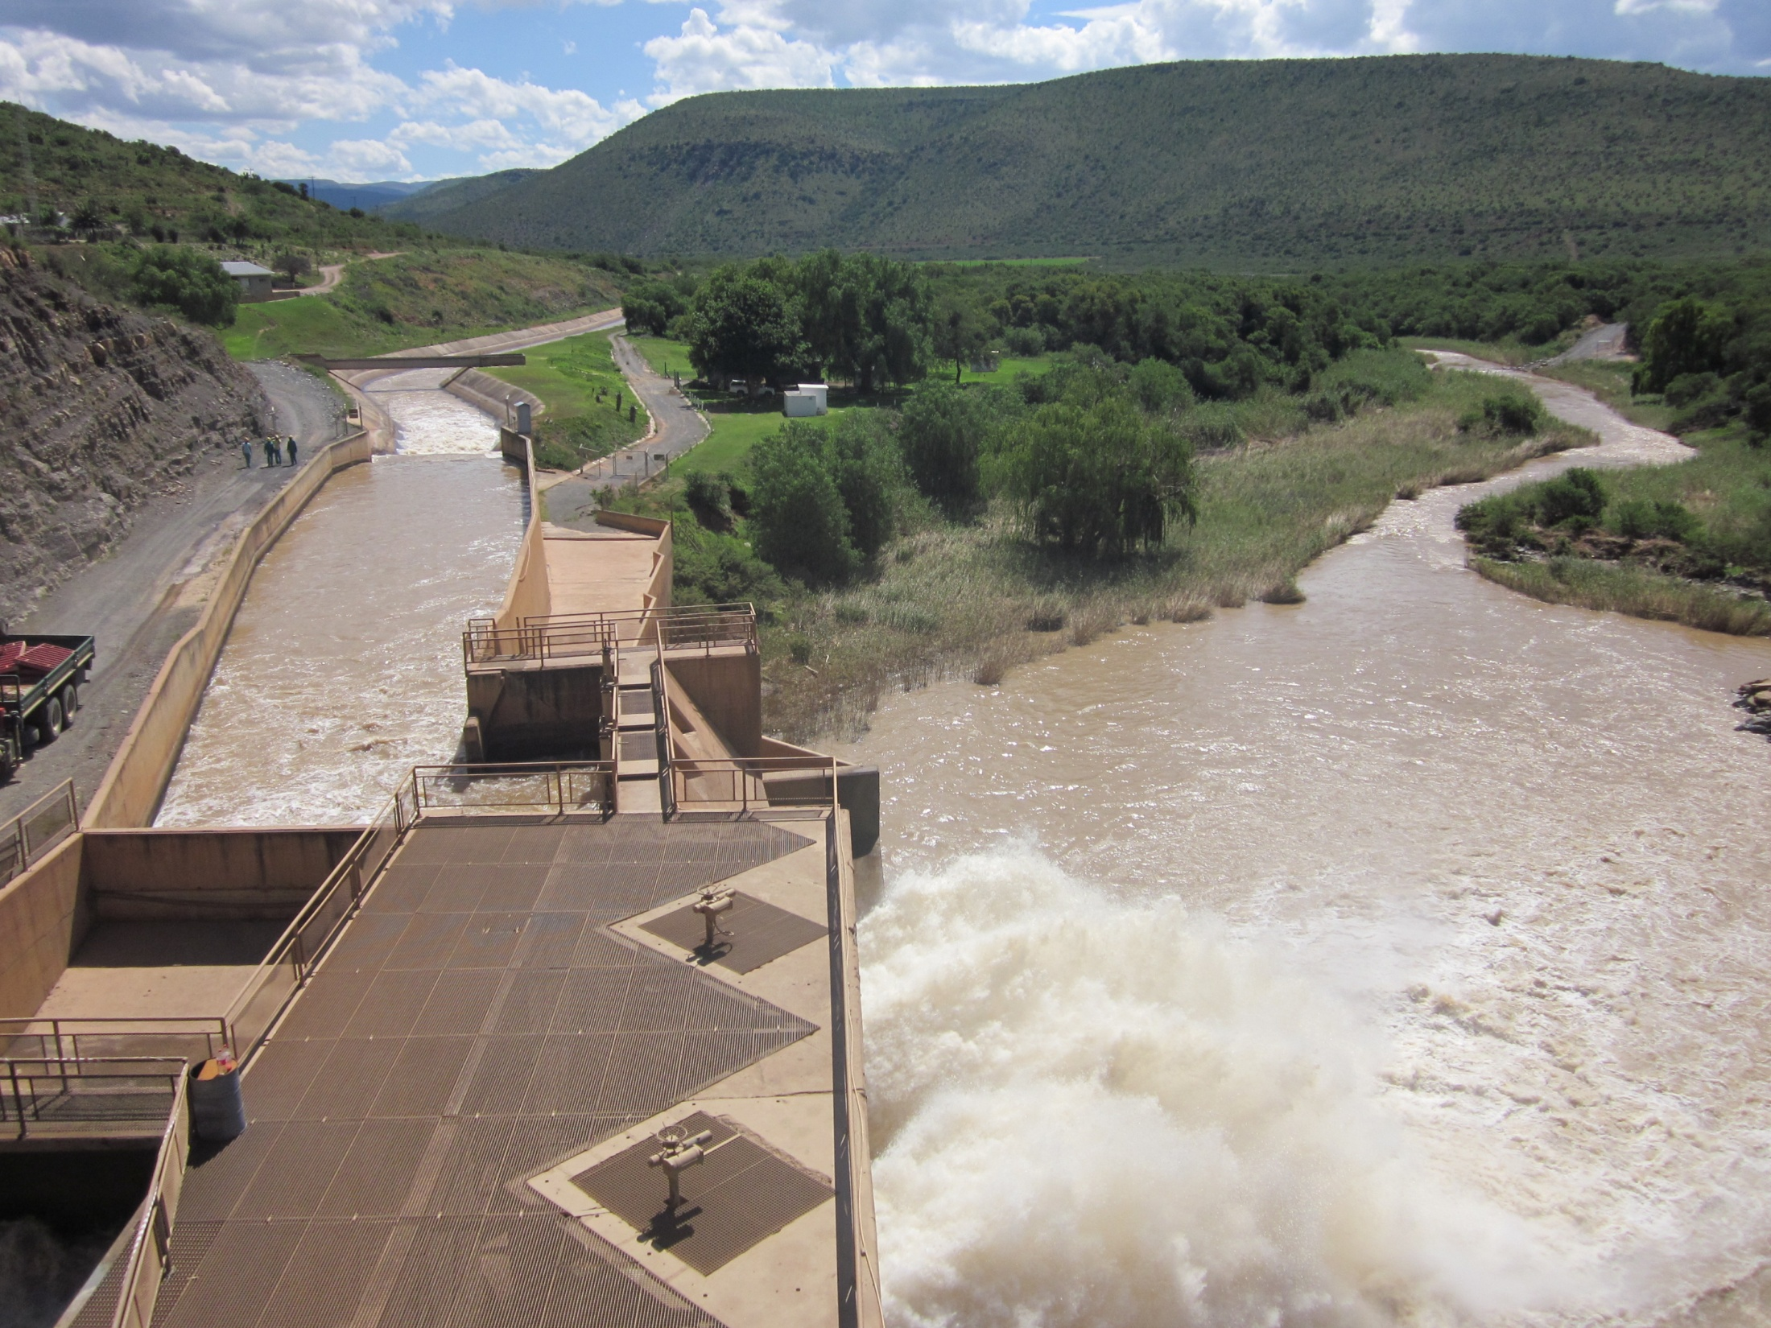
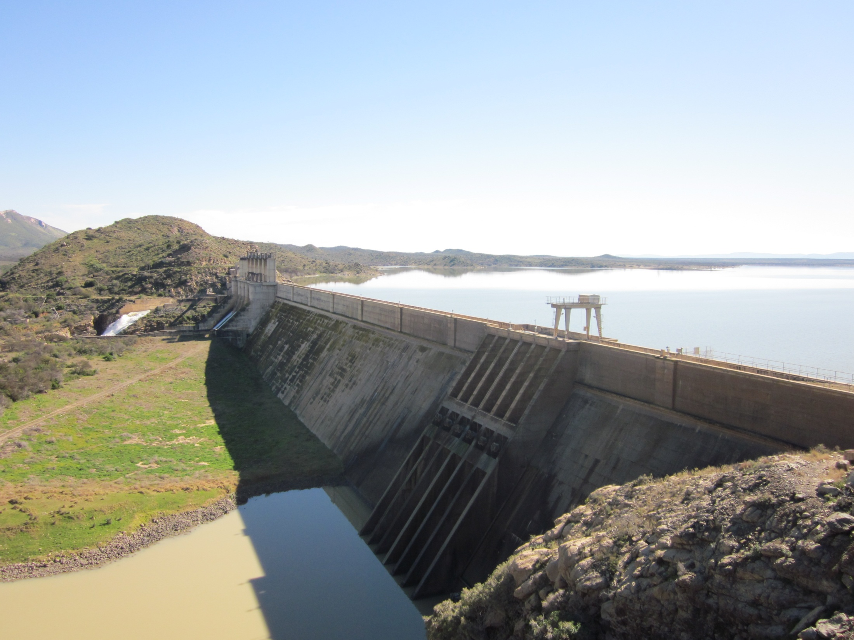
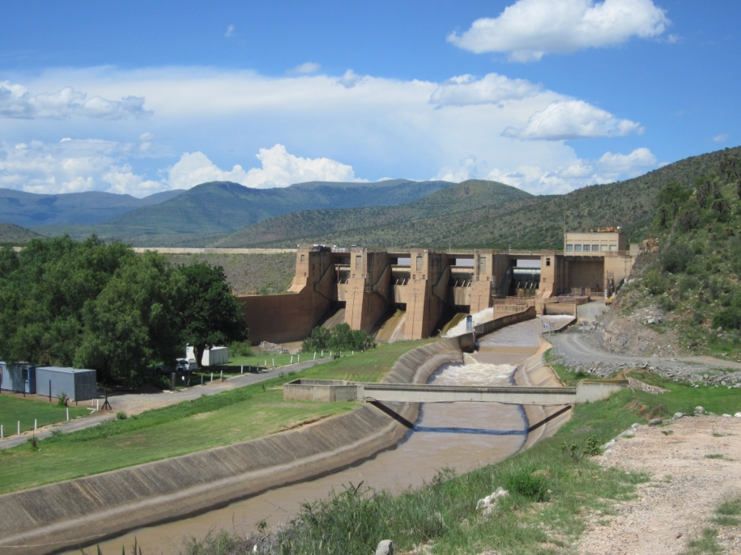
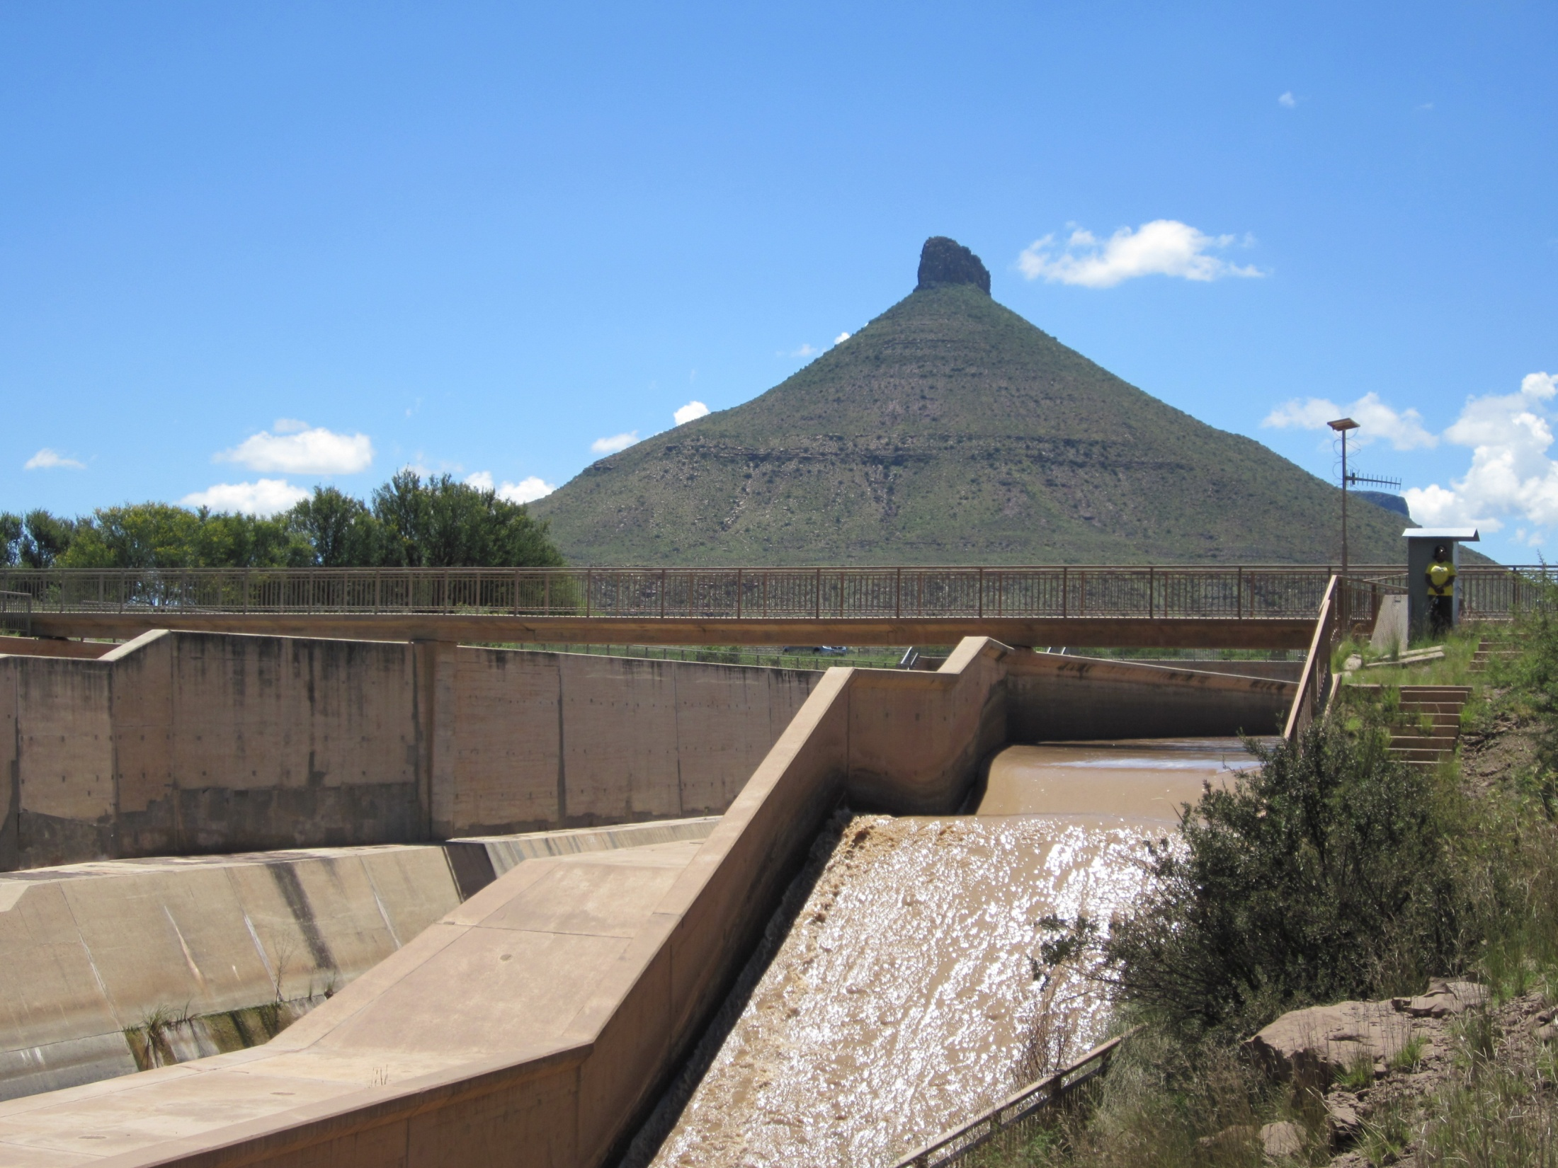


Slide 5
INTRODUCTION: Challenges and Objectives
Challenges
Fairly large system
  > 1 000 km of tunnels, rivers and canals
  2 reservoirs & 4 diversion weirs
  > 150 water users
  Approx. 48 000 ha of irrigation (Fish: 31 000 ha; Sundays 17 000 ha)
  Volume ±700mil m³ / annum
7 large operational releases
Water salinity a problem due to arid region and irrigation return flows
  Requires dilution to maintain acceptable TDS
Objective
Implement a management and simulation framework to assist with operations

Slide 6
BACKGROUND
Simulation Support for Operations
ViSun (Vis-Sondags) model – DWA developed and run tool
University of Stellenbosch & DHI (2007 – 2009)
  MIKE Floodwatch and MIKE 11
Potential Issues
Capacity & Understanding
Model configuration and accuracy
Framework Stability
Ease of access to information
This Project…
Improve and maintain the MIKE Floodwatch and MIKE 11 framework deployed in initial project

Slide 7
FRAMEWORK DESCRIPTION:
What is required for OFS-RT?
What do we actually require to implement a near-real-time DSS to support river operations!?
ACCESS TO DATA AND COMMUNICATION
OPERATOR!!
Framework
Simulation Model
Water Use and Water User Aspects
Demand for Water
Water Allocation
Current Status of system in catchment
Dam Levels
River Flows

Slide 8
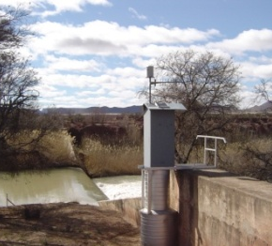
FRAMEWORK DESCRIPTION:
OFS-RT DSS Framework Architecture
Located on Intranet Server
(Pretoria)
SMS
Dashboard Manager
Cradock Hydro
Dashboard Data
Call
Located at PE
Hydras3
File Transfers
Data
Located at PE
Located at PE
Water Demand
MIKE Floodwatch
Pretoria
Data
RT Web
Data
MIKE 11
Located at PE
Scenarios
Pretoria
Approval
Model
Hydstra
Data
Data

Slide 9
SIMULATION MODELLING:
MIKE 11 Simulation Model
MIKE 11 is a one dimensional hydrodynamic model
Simulating both flow and water quality (TDS) components in the OFS network
Configured by University of Stellenbosch and DHI Denmark as part of previous project
Utilises the data assimilation module to correct model output up to time of forecast with the real-time observations from the field
Run on a time scale of 10 days, 5 days hind cast, 5 days forecast

Slide 10
SIMULATION MODELLING:
Outputs / Objectives
Outputs / Objectives of model:
Ensure irrigation demands are satisfied
Maintain water quality to acceptable limits
Maintain minimum environmental flow
Maintain reservoir levels at specified limits
Safe operation of reservoirs during floods
Divert excess flood water
Provide forecasts of water flow and TDS at key network locations
These are satisfied by recommending decision support for 7 releases:
  OVIS tunnel
  Grassridge River
  Elandsdrift River
  Elandsdrift Canal
  DeMistkraal River
  DeMistkraal Canal
  Darlington River

Slide 11
SIMULATION MODELLING:
Example Model Outputs
Example model output based on data stored in framework: Nov & Dec 2011
  Simulated vs. observed flow
  Simulated vs. observed TDS

Slide 12
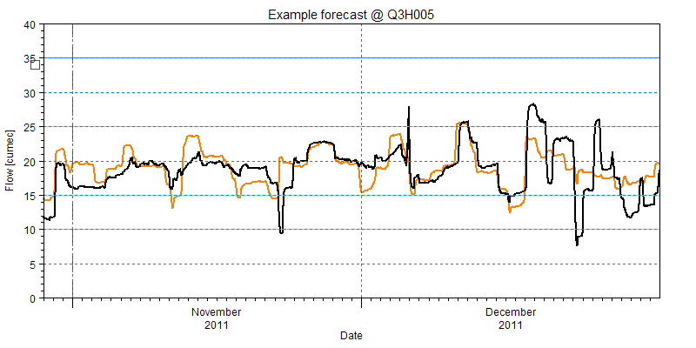
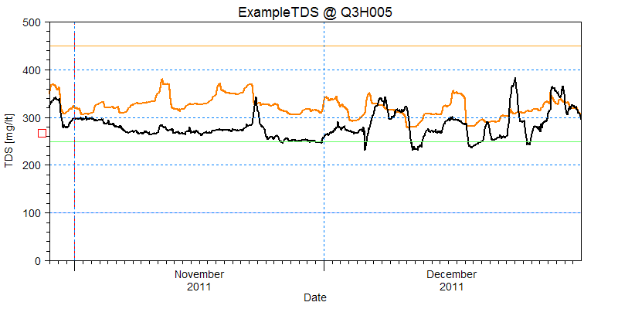
SIMULATION MODELLING:
Q3H005 - Waaikraal (River Gauge)

Slide 13
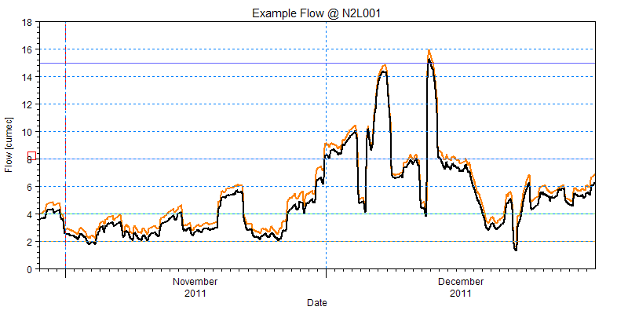
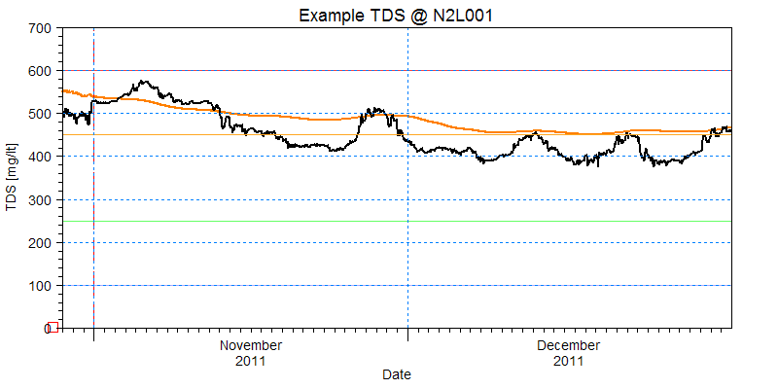
SIMULATION MODELLING:
N2L001 – Parshall 3 (Canal Gauge)

Slide 14
SIMULATION MODELLING:
Notes on Model Outputs
Always remember…
  Quality of model outputs is directly related to inputs
  How accurate is the gauged data?
  How accurate are the water demand requests?
  How accurately do lower level operators follow instructions?
  Difficult to accurately account for variable inflows and losses

Slide 15
WATER USER MANAGEMENT [1]
Water requests by water users is the main driver in operations and the modelling framework
Accuracy of the request, both timing and quantity is variable between water users
Sometimes the request is completely inaccurate
It has follow on implications for the simulation model
Many of the water users are also gauged (±75 %)
Comparisons and auditing of water users is possible
  Water Request vs. Actual Use
  Actual Use vs. Water Allocation

Slide 16
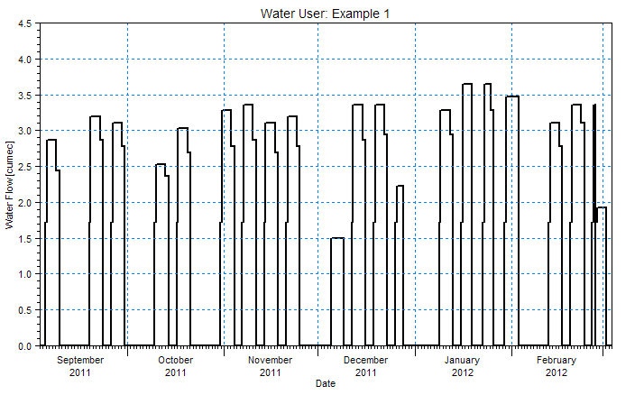
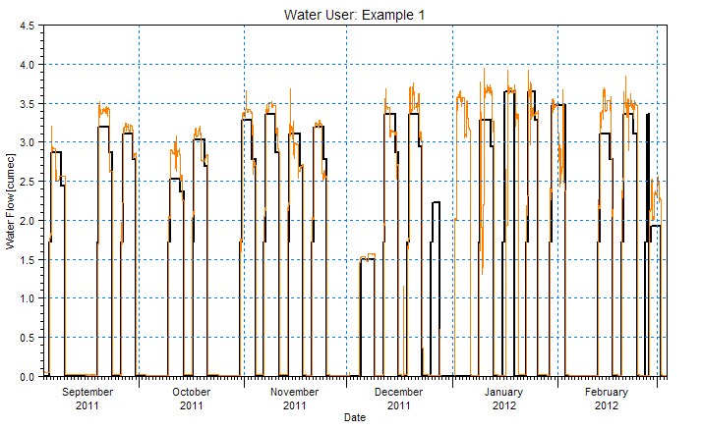
WATER USER MANAGEMENT [2]

Slide 17
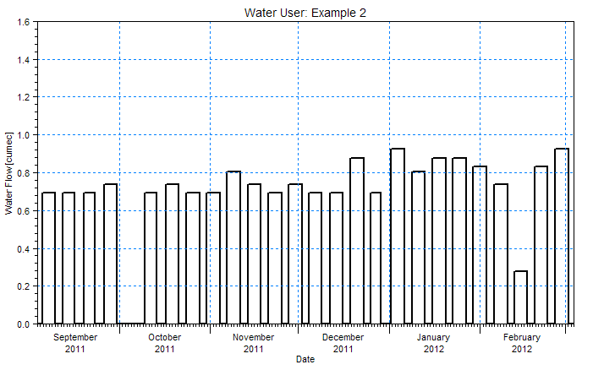
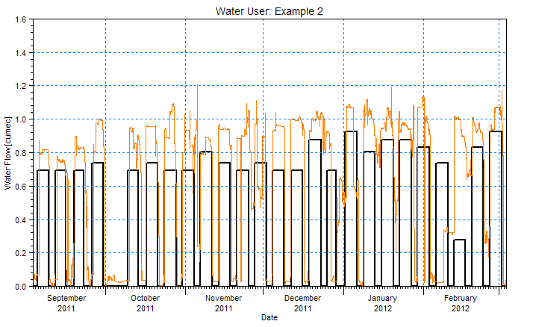
WATER USER MANAGEMENT [3]

Slide 18
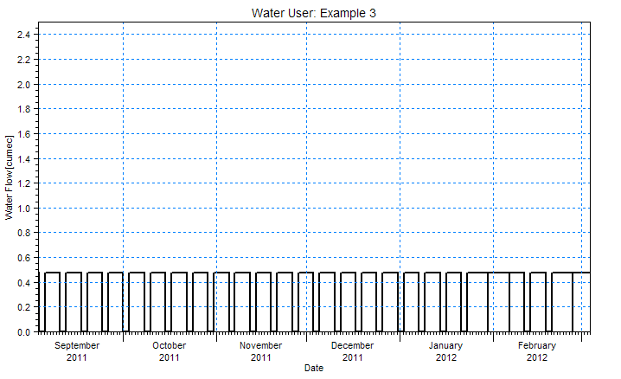
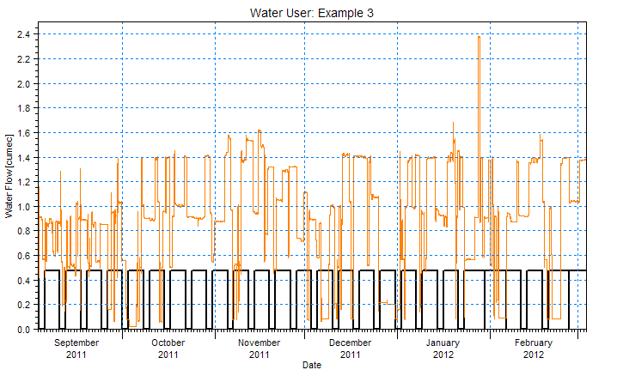
WATER USER MANAGEMENT [4]

Slide 19
WATER USER MANAGEMENT [5]
Framework is also used to check abstraction compliance of water users with annual allocation
Water users are divided into sequential sections of the transfer scheme for summary purposes

Slide 20
PROJECT DASHBOARDS
Web based dashboards for wider dissemination of information
Running off DWA IT infrastructure
Summaries of:
  River and reservoir data
  Water quality data
  Water requests by users
  MIKE 11 model forecasts
  Water user auditing
www.ofs-rt.co.za / http://www6.dwa.gov.za/ofsrt/

Slide 21
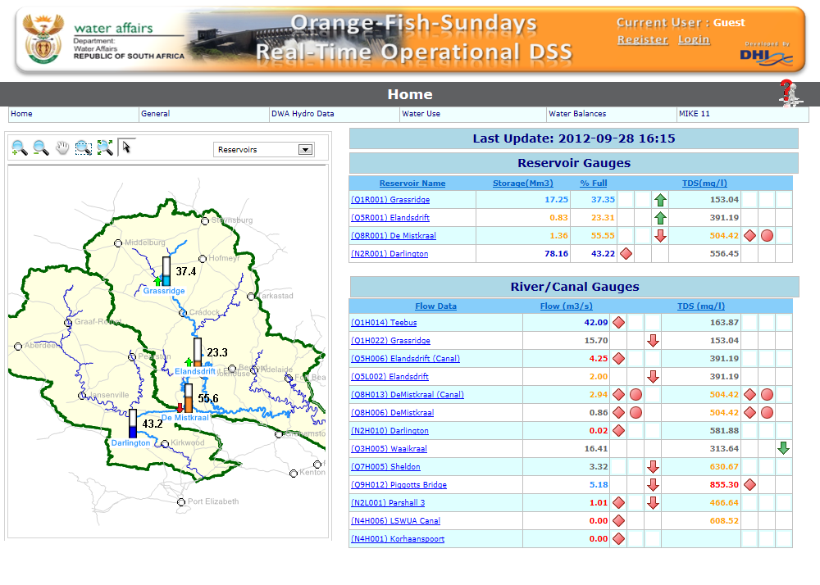

Slide 22
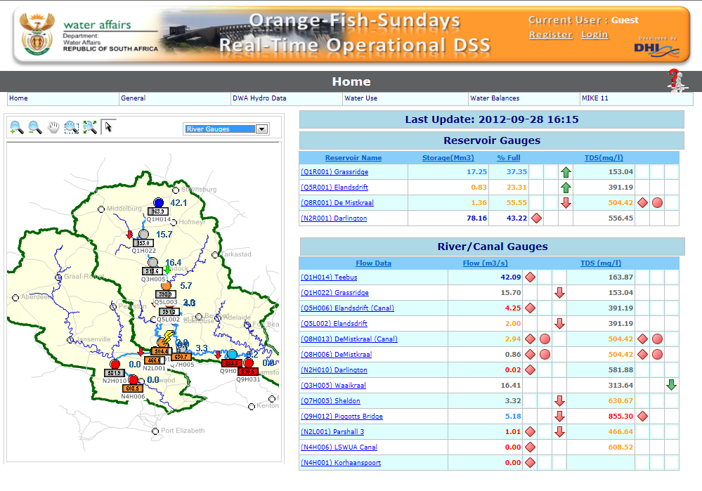

Slide 23
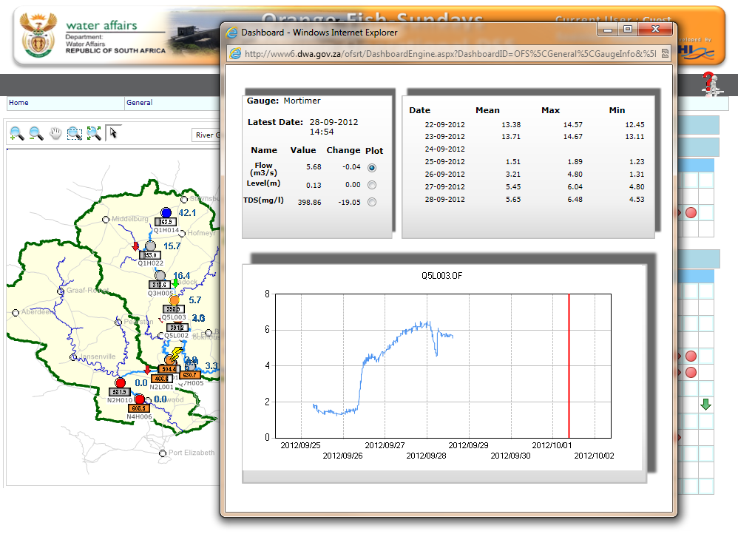

Slide 24
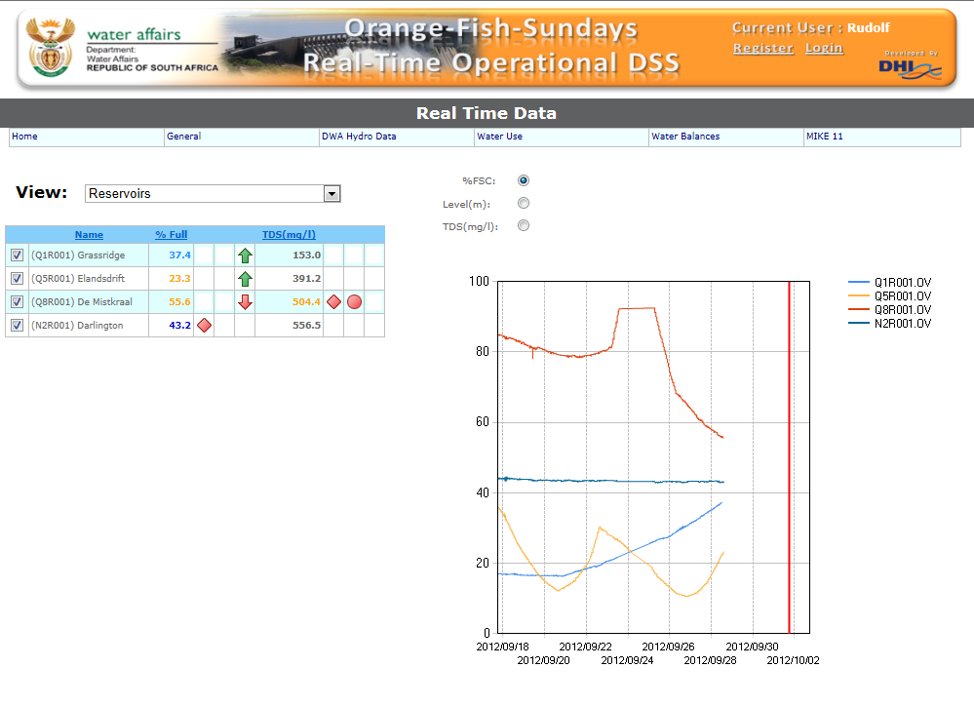

Slide 25
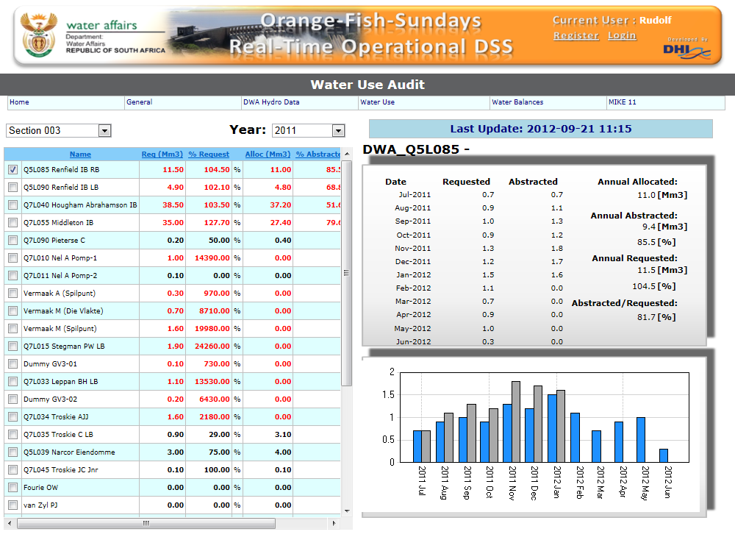

Slide 26
CONCLUSIONS, OUTCOMES & RECOMMENDATIONS
All components for real-time operational management are present in scheme
  Extensive and well maintained gauging structures
  Existing model solution and good institutional knowledge in DWA
  Requirement and potential to minimise operational losses from DWA
  Committed operators with required skills for the OFS system
MIKE 11 Hydrodynamic Model running with real-time hydrological data and water requests submitted by users
MIKE Floodwatch forecasting framework is managing data acquisition, processing and model runs

Slide 27
CONCLUSIONS, OUTCOMES & RECOMMENDATIONS
Web based dashboards for information dissemination
Good communication on weekly and daily basis
  Between different DWA operational staff
  Between DWA and WUAs
Being run by DWA staff off DWA IT infrastructure
Goal is to continue using the framework to improve water distribution, maintain acceptable water quality and minimise wastage
Acknowledge all DWA directorates and colleagues that have contributed with ideas, data, enthusiasm and funding

Slide 28
Thank you!

